Slide 1
UNIT-3

Slide 2
objectives
Investigative Process
Analysis Framework
File Systems
FAT
NTFS next week
EXT3

Slide 3
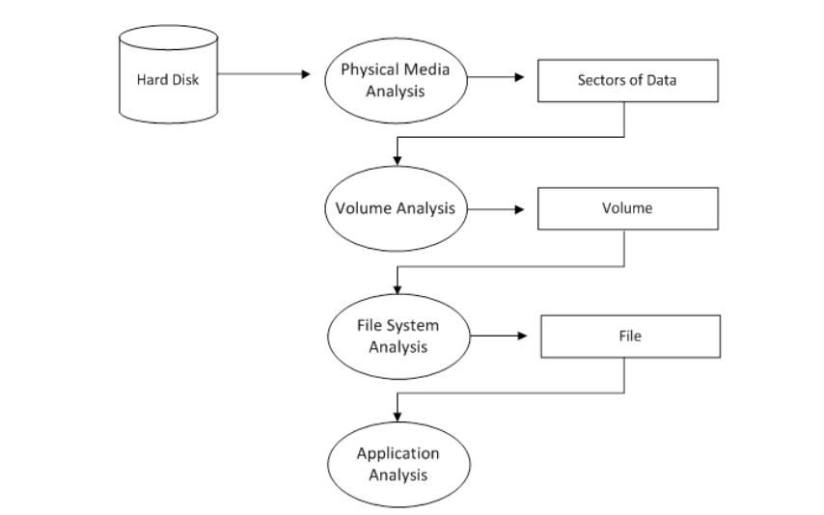
Investigative process

Slide 4
Analysis Framework
B Carrier, File System Forensic Analysis
Data Categories provide a basic reference model
Good for comparing different file system types
Also allows us to understand how to search using various tool types
Categories
File System Category
Content Category
Metadata Category
File Name Category
Application Category

Slide 5
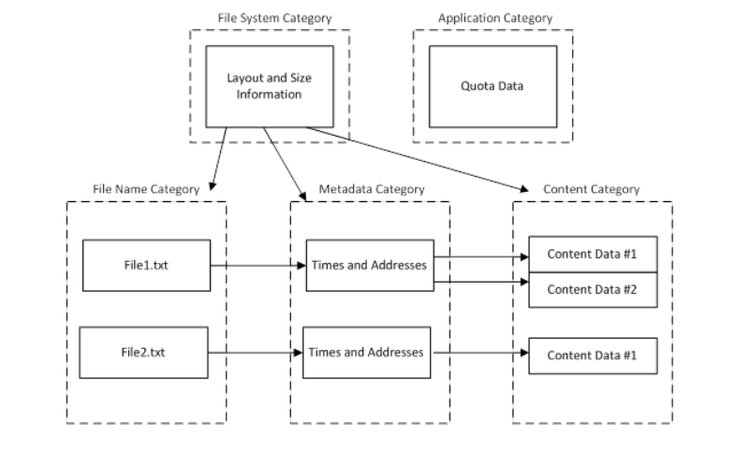
File System Category

Slide 6
Analysis by Category
Categories are important as they allow us to filter and search for files
For example, if we want to search for all images
GIF, JPEG
Search for all files ending in .gif or .jpg, OR their file-header
File System Category
All file systems have a general structure
Informs of where to find data structures
Think of this as a map
File system data resides on the first few sectors of the disk
If corrupted, rebuilding by hand may need to occur
Small amounts of data hiding can occur due to the sparse usage of the pre-allocated data structures

Slide 7
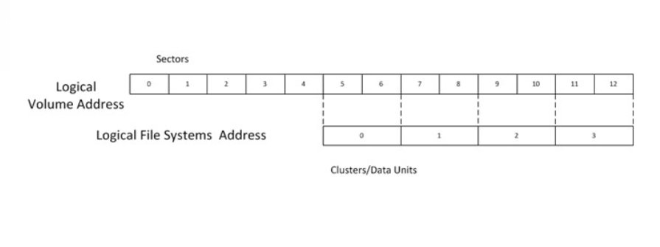
Disk and File System Layout

Slide 8
Content Category
Actual content of the file
Contains the majority of the actual data
Usually organised into standard-sized containers
Clusters
Data Unit
Allocation Strategy
First Available
Next Available
Best Fit

Slide 9
Analysis Techniques
Data unit viewing
viewing content of the logical file system address using hex editor
dcat
Logical file system-level searching
searches each data unit for know value
Data unit Allocation Status
bitmap – data structure of allocated data units (marked as “1”) and unallocated data units (marked as “0”)

Slide 10
Metadata Category
Where the descriptive data resides
Last access time
Data units allocated to the file
Provides pointers to the address of the Logical File Address
MAC times
Modification, Access, Change

Slide 11
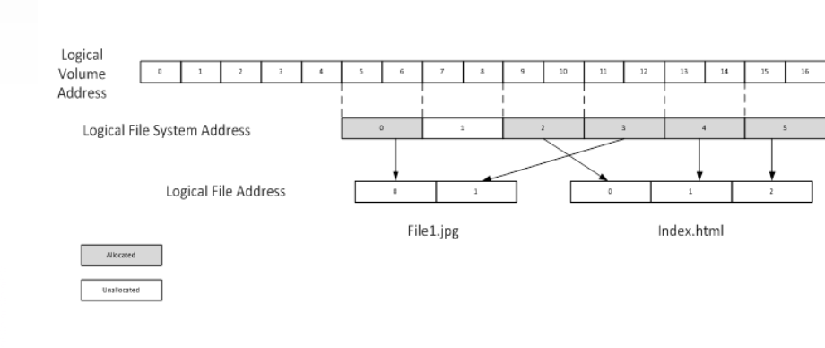
File Addressing

Slide 12
Analysis Techniques
Metadata Lookup
istat – shows values from the metadata data structure
Logical file viewing
icat - shows the content data for a given metadata structure
-s option gives slack space
-r attempts to recover deleted files

Slide 13
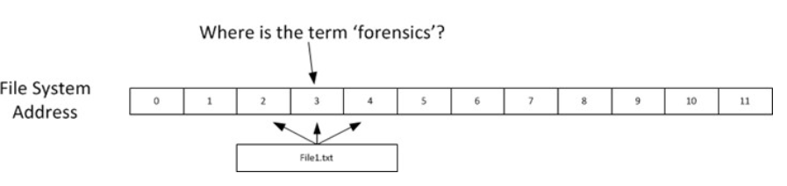
Linking Data Units to Files
ifind allows you to discover the rest of the data units allocated to a file
E.g. if we find something interesting in data unit 3, and want to look at the rest of the file

Slide 14
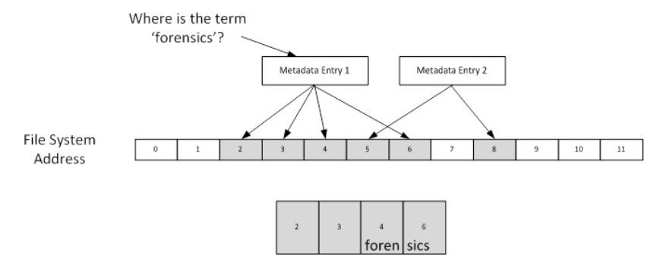
File Searching
Logical File Search
Looks at the file-address level, takes into account fragmentation
Logical File Address allocated units only

Slide 15
Slack Space
Disks are block-based
Example – File1.txt
700 byte file
Needs to allocate full data unit (2,048 bytes)
The remaining 1,348 would be slack
Two interesting areas:
Between end of file and end of sector
Allocated Data Unit Sectors that contain no file content

Slide 16
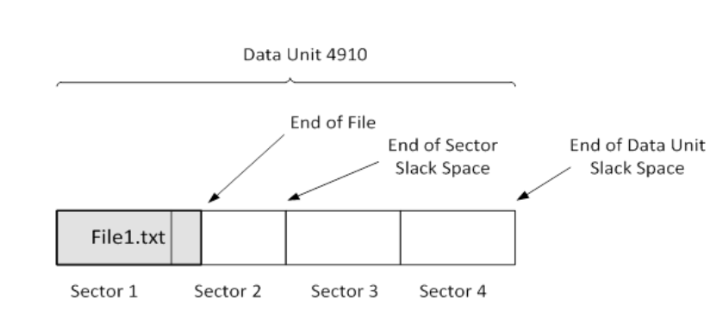
End of file /sector space is sometimes padded with 0’s – in older systems this was random data from memory
End of Data unit is either wiped and padded with zero’s, or it is not wiped, thus containing data from previously allocated files.

Slide 17
Unallocated Metadata
File names may be deleted, but metadata may still exist
Examine the metadata as this may contain evidence
The tool ils will list unallocated structures
Metadata Searching
Allows time-based evaluation of activities
Timelining events
MAC
Modified
Access
Change
Also owner ID and file permissions
mactime tool in CAINE

Slide 18
File Name Category
Includes names of files
Allows a user to find a file by name, instead of its metadata entry
When recovering files based on file names
We are still reliant on the metadata information
File names and metadata can get out of sync
File Name Analysis Techniques
File Listings – locate root directory and obtain list of files and corresponding metadata addresses
File Name Searching - file extension filtering and searching
ffind - resolve metadata to file names
When evidence in a data unit is found, search for the metadata unit allocated, search for file name

Slide 19
Application Category
Non-Essential Data – file system journals
Can be application specific data
Search
grep
Data carving
File type sorting
Use file command to determine file types based on file signatures

Slide 20
File Systems
An operating system requires long term storage and retrieval
A mechanism for storing files in hierarchy of files and directories
For example, a patient record filing system
Data
Files
Directories
Metadata Structures
Time stamps (modify, access, create/change, delete)
Owner
Security properties
Structures
Superblock/Master File Table/File Access Table
inodes/clusters
data

Slide 21
File Systems
More sophisticated data recovery requires deep knowledge of file system internals
Structures that manage file system metadata
Disk layout
File deletion issues
Many important file systems
DOS / Windows: FAT, FAT16, FAT32, NTFS
Unix: ext2, ext3, Reiser, JFS
Mac: MFS, HFS, HFS+

Slide 22
Five Data Categories of File System
FAT: FAT (File Allocation Table) is a type of file system, which is developed for hard drives. It stands for file allocation table and was first introduced in 1977
GFS: A GFS is a file system, which stands for Global File System. It has the ability to make enable multiple computers to act as an integrated machine,
HFS: HFS (Hierarchical file system) is the file system that is used on a Macintosh computer for creating a directory at the time a hard disk is formatted. Generally, its basic function is to organize or hold the files on a Macintosh hard disk.
NTFS: NTFS is the file system, which stands for NT file system and stores and retrieves files on Windows NT operating system and other versions of Windows like Windows 2000, Windows XP, Windows 7, and Windows 10.
UDF: A UDF is a file system, stands for Universal Disk Format and used first developed by OSTA (Optical Storage Technology Association) in 1995 for ensuring consistency among data written to several optical media.

Slide 23
Types of File Systems
Disk File Systems
Flash File Systems
Tape File Systems
Database File Systems
Transactional File Systems
Network File Systems
Shared Disk File Systems
Minimal File Systems
Flat File Systems

Slide 24
FAT
FAT (File Allocation Table) file systems are a legacy format that originated in DOS and Windows 9x
Reasons why Windows supports FAT file systems:
to enable upgrades from other versions of Windows
compatibility with other operating systems in multiboot systems
as a floppy disk format
Windows FAT file system driver is implemented in \Winnt\System32\Drivers\Fastfat.sys
Each FAT format includes a number that indicates the number of bits the format uses to identify clusters on a disk
Boot sector
File allocation table 1
File allocation table 2 (duplicate)
Root directory
Other directories and all files
FAT format organization

Slide 25
File Systems: FAT
FAT12, FAT16, FAT32
different size of addressable cluseter
Common format for floppy disks (remember those?)
Limited time/date information for FAT files
Last write date/time is always available
Creation date/time is optional and may not be available
Last access DATE ONLY is optional and may not be available
Short file names (8.3) on FAT12 and FAT16
No security features
Long names for FAT32

Slide 26
FAT12
FAT12's 12-bit cluster identifier limits a partition to storing a maximum of 212 (4096) clusters
Windows uses cluster sizes from 512 bytes to 8 KB in size, which limits a FAT12 volume size to 32 MB
Windows uses FAT12 as the format for all 5-inch floppy disks and 3.5-inch floppy disks, which store up to 1.44 MB of data

Slide 27
FAT16
FAT16, with a 16-bit cluster identifier, can address 216 (65,536) clusters
On Windows, FAT16 cluster sizes range from 512 bytes (the sector size) to 64 KB, which limits FAT16 volume sizes to 4 GB
The cluster size Windows uses depends on the size of a volume

Slide 28
FAT32
FAT32 is the most recently defined FAT-based file system format
it's included with Windows 95 OSR2, Windows 98, and Windows Millennium Edition
FAT32 uses 32-bit cluster identifiers but reserves the high 4 bits, so in effect it has 28-bit cluster identifiers
Because FAT32 cluster sizes can be as large as 32 KB, FAT32 has a theoretical ability to address 8 TB volumes
Although Windows works with existing FAT32 volumes of larger sizes (created in other operating systems), it limits new FAT32 volumes to a maximum of 32 GB
FAT32's higher potential cluster numbers let it more efficiently manage disks than FAT16; it can handle up to 128-MB volumes with 512-byte clusters
Unlike FAT12 and FAT16, root directory is not fixed size or location
Largest file size on Windows is 4GB (largest on Win9x is 2G)

Slide 29
FAT: Short Filename Storage
“foo.bar” -> “FOO BAR”
“FOO.BAR” -> “FOO BAR”
“Foo.Bar” -> “FOO BAR”
“foo” -> “FOO ”
“foo.” -> “FOO ”
“PICKLE.A” -> “PICKLE A ”
“prettybg.big” -> “PRETTYBGBIG”
Note case is not significant
“.” between primary filename and extension is implied (not actually stored)
Further, everything is space-padded

Slide 30
FAT: More Dir Entry Details
Date format:
Bits 0–4: Day of month, valid value range 1-31 inclusive.
Bits 5–8: Month of year, 1 = January, valid value range 1–12 inclusive.
Bits 9–15: Count of years from 1980, valid value range 0–127 inclusive (1980–2107).
Time Format:
A FAT directory entry time stamp is a 16-bit field that has a granularity of 2 seconds
Bits 0–4: 2-second count, valid value range 0–29 inclusive (0 – 58 seconds).
Bits 5–10: Minutes, valid value range 0–59 inclusive
Bits 11–15: Hours, valid value range 0–23 inclusive

Slide 31
FAT: Long Filenames
Summary: a kludge to add support without changing short-name handling
Up to 255 characters in pathname component
Total pathname no longer than 260
More supported characters
Leading/trailing spaces ignored
Internal spaces allowed
Leading/embedded “.” allowed
Trailing “.” are ignored
Stored case-sensitive
Processed case-insensitive (for compatibility)
File created with short name (uses “~1”, “~2”, etc. suffix)

Slide 32
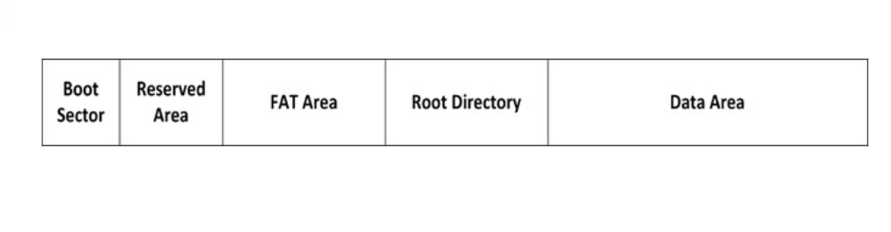
FAT Layout

Slide 33
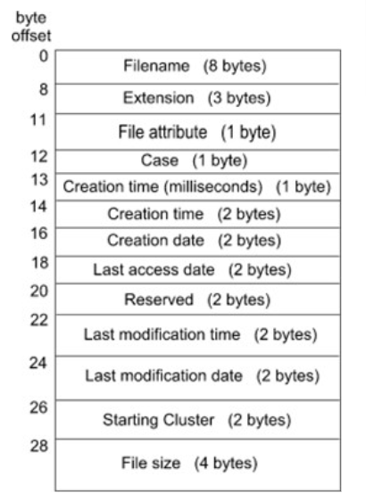
FAT32 Directory Structure
An ordinary cluster chain
Directory entry
32 bytes for both files and directories
For deleted entries, first byte is set to 0xE5
First two entries in subdirectories are . and ..
Uses more than one entry to implement
long filenames

Slide 34
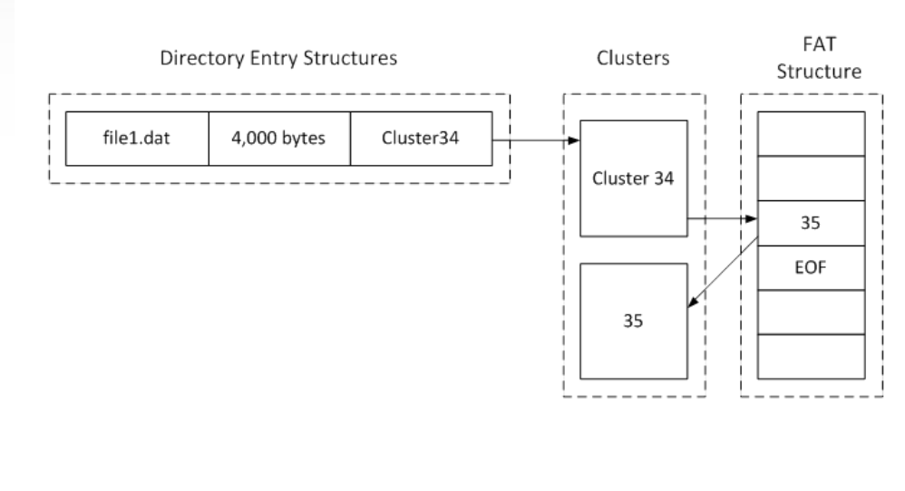

Slide 35
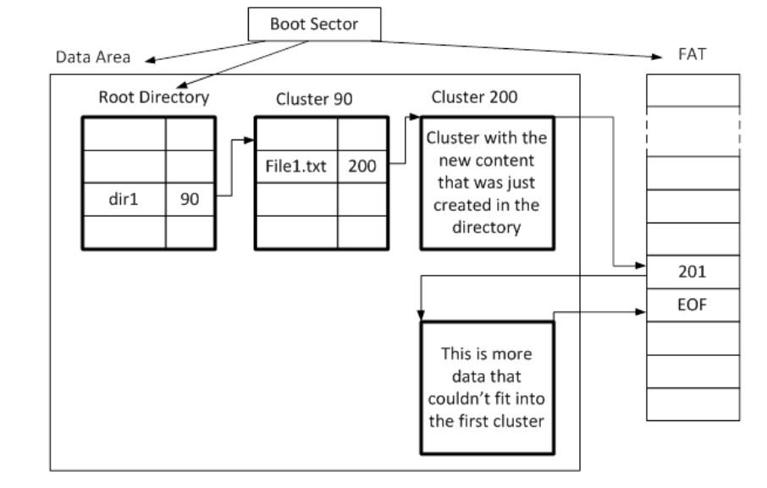
Creating a File

Slide 36
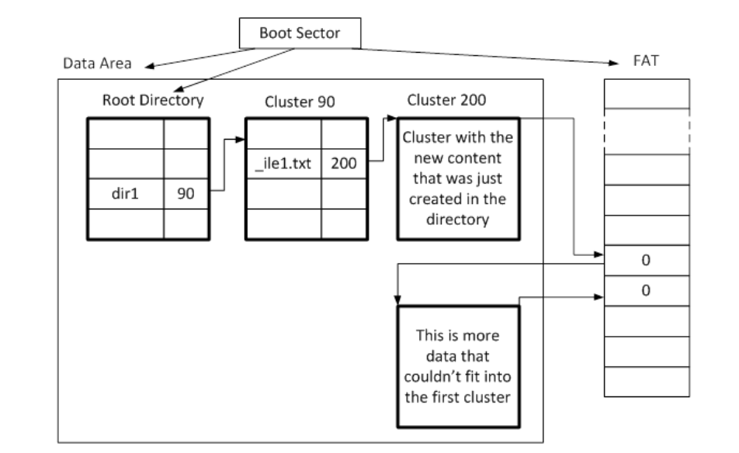
File Deletion

Slide 37
FAT File Deletion
First letter of the file is overwritten with 0xE5
FAT pointers to allocation areas set to zero
Indicated that they are ready for re-use

Slide 38
Forensic Analysis - Examples
fsstat - display general details of a file system
FILE SYSTEM INFORMATION
File System Type: FAT16
OEM Name: MSDOS5.0
Volume ID: 0x3abd23ec
Volume Label (Boot Sector): NO NAME
Volume Label (Root Directory):
File System Type Label: FAT16
Sectors before file system: 32
File System Layout (in sectors)
Total Range:
* Reserved: 0 - 5
** Boot Sector: 0
* FAT 0:6-250
* FAT 1:251-495
* Data Area:496-2003919
** Root Directory:496-527
** Cluster Area:528-2003935
** Non-clustered:2003920-2003935

Slide 39
fsstat (continue)
METADATA INFORMATION
Range:2-32055046
Root Directory: 2
CONTENT INFORMATION
Sector Size: 512
Cluster Size: 16384
Total Cluster Range:2 - 62607
FAT CONTENTS (in sectors)
528-559(32) -> EOF
560-591(32) -> EOF
592-623(32) -> EOF
624-687(64) -> EOF
688-719(32) -> EOF
720-751(32) -> EOF

Slide 40
fls - list file and directory names in a disk image
d/d 4: Project_2010
d/d 6: Report2010
d/d 8: Other
v/v : $MBR
v/v : $FAT1
v/v : $FAT2
d/d : $OrphanFiles

Slide 41
istat - Display details of a meta-data structure (i.e. inode)
Directory Entry: 6
Allocated
File Attributes: Directory
Size: 16384
Name: REPORT~1
Directory Entry Times:
Written: Thu Oct 20 06:36:
Accessed: Thu Oct 20 00:00:
Created: Thu Oct 20 06:36:
Sectors:
1489 1490 1491 1492 1493 1494 1495
1496 1497 1498 1499 1500 1501 1502
1503 1504 1505 1506 1507 1508 1509
1510 1511 1512 1513 1514 1515 1516

Slide 42
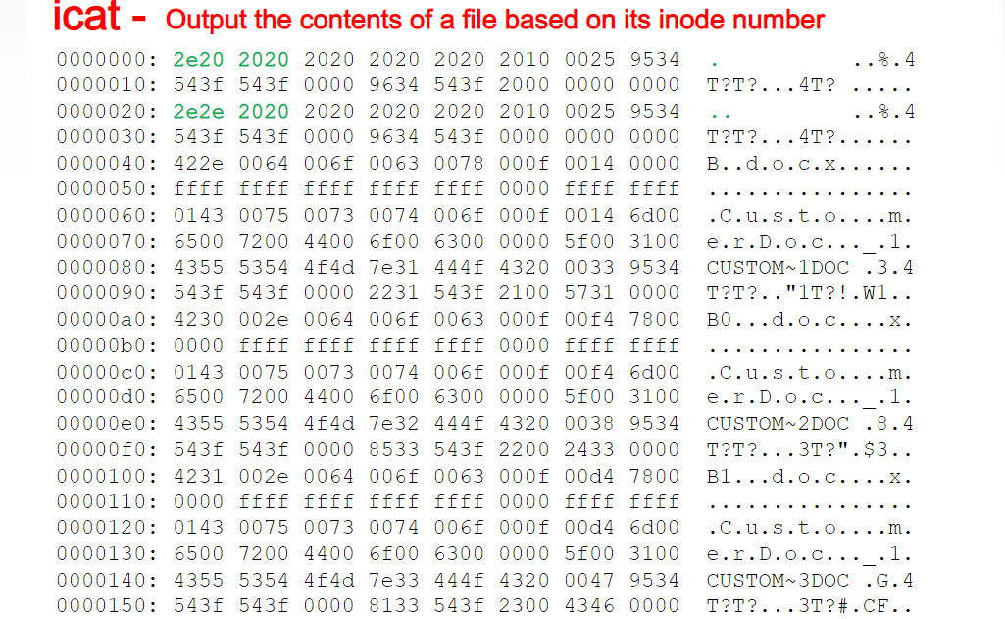
icat - Output the contents of a file based on its inode number

Slide 43
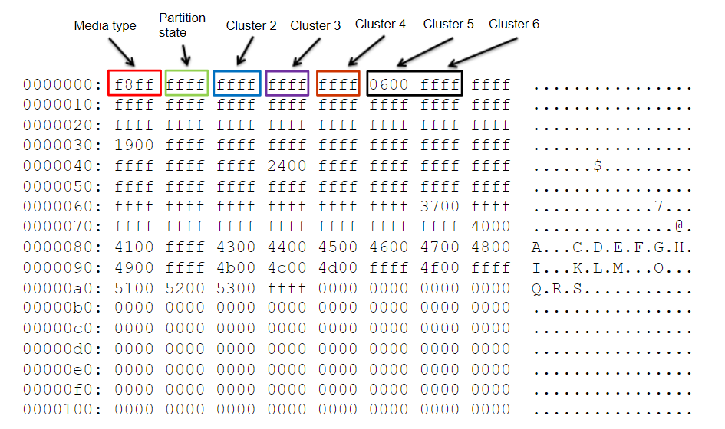
FAT Allocation Table

Slide 44
NTFS- Roadmap
File Systems supported by Windows NTFS Design Goals
File System Driver Architecture
NTFS Operation
Windows File System On-Disk Structure
NTFS File Compression

Slide 45
Windows File System - Terminology
Sectors:
hardware-addressable blocks on a storage medium
Typical sector size on hard disks for x86-based systems is 512 bytes
File system formats:
Define the way data is stored on storage media
Impact a file system features: permissions & security, limitations on file size, support for small/large files/disks
Clusters:
Addressable blocks that many file system formats use
Cluster size is always a multiple of the sector size
Cluster size tradeoff: space efficiency vs. access speed

Slide 46
Windows File System - Terminology
Metadata:
Data stored on a volume in support of file system format management
Metadata includes the data that defines the placement of files and directories on a volume, for example
Typically not accessible to applications

Slide 47
Formats Supported by Windows
CD-ROM File System (CDFS)
Universal Disk Format (UDF)
File Allocation Table (FAT12, FAT16, and FAT32)
New Technology File System (NTFS)

Slide 48
CDFS
CDFS, or, is a relatively simple format that was defined in 1988 as the read-only formatting standard for CD-ROM media.
Windows 2000 implements ISO 9660-compliant CDFS in \Winnt\System32\Drivers\Cdfs.sys, with long filename support defined by Level 2 of the ISO 9660 standard
Because of its simplicity, the CDFS format has a number of restrictions
Directory and file names must be fewer than 32 characters long
Directory trees can be no more than eight levels deep
CDFS is considered a legacy format because the industry has adopted the Universal Disk Format (UDF) as the standard for read-only media

Slide 49
UDF
OSTA (Optical Storage Technology Association) defined UDF in 1995 as a format to replace CDFS for magneto-optical storage media, mainly DVD-ROM
The Windows 2000 UDF file system implementation is ISO compliant and supports UDF versions 1.02 and 1.5
UDF file systems have the following traits:
Filenames can be 255 characters long
The maximum path length is 1023 characters
Although the UDF format was designed with rewritable media in mind, the Windows 2000 UDF driver (\Winnt\System32\Drivers\Udfs.sys) provides read-only support

Slide 50
NTFS
NTFS is the native file system format of Windows
NTFS uses 64-bit cluster indexes
Theoretical ability to address volumes of up to 16 exabytes (16 billion GB)
Windows 2000 limits the size of an NTFS volume to that addressable with 32-bit clusters, which is 128 TB (using 64-KB clusters)
Why use NTFS instead of FAT? FAT is simpler, making it faster for some operations, but NTFS supports:
Larger file sizes and disks
Better performance on large disks, large directories, and small files
Reliability
Security

Slide 51
File System Format Compatibility
FAT12/FAT16 supported on all Microsoft OS’s
FAT32:
Only Windows 2000/XP/2003
Winternals FAT32 driver for NT4
NTFS:
Only Windows NT-based OS’s
Winternals NTFSDOS for DOS access
Winternals NTFS for Windows 98 for Win9x/Me

Slide 52
NTFS Design Goals
Overcome limitations inherent in FAT / HPFS
FAT (File Allocation Table) does not support large disks very well
FAT16 (MS-DOS file system) supports only up to 216 clusters and 2 GB disks (with 64 Kb clusters!!)
FAT / root directory represents single point of failure
Number of entries in root directory is limited
HPFS removed some of FAT‘s limitations, but still did not support recoverability, security, data redundancy, and fault-tolerance (later versions of HPFS support up to 2TeraByte disks)

Slide 53
NTFS Recoverability
PC disk I/O in the old days: Speed was most important
NTFS changes this view – Reliability counts most:
I/O operations that alter NTFS structure are implemented as atomic transactions
Change directory structure,
extend files, allocate space for new files
Transactions are either completed or rolled back
NTFS uses redundant storage for vital FS information
Contrasts with FAT / HPFS on-disk structures, which have single sectors containing critical file system data
Read error in these sectors -> volume lost

Slide 54
NTFS Security and Recoverability
NTFS security is derived from Windows object model
Open file is implemented as file object; security descriptor is stored on disk as part of the file
NT security system verifies access rights when a process tries to open a handle to any object
Administrator or file owner may set permissions
NTFS recoverability ensures integrity of FS structure
No guarantees for complete recovery of user files
Layered driver model + FTDISK driver
Mirroring of data – RAID level 1
Striping of data - RAID level 5 (one disk with parity info)

Slide 55
Large Disks and Large Files
Efficient support for large files and disks in NTFS
FAT16:
16-bit wide table stores allocation status of disk
Up to clusters per volume (#files !!); adjustable cluster size
FAT32:
New in since Windows 2000
4kb clusters on volumes up to 8 GB
Can relocate root directory / use backup copy of FAT
Root directory is ordinary cluster chain – no limits on #entries
HPFS (support dropped in NT 4.0):
32 bits to enumerate allocation units; maximum file size: 4GB
Allocates disk space in terms of physical sectors of 512 bytes; problem with some disks (1024 bit sectors)

Slide 56
Large Disks and Large Files (contd.)
NTFS enumerates cluster with 64-bit numbers
Up to 264 clusters of up to 64 Kbytes size
Maximum file size: 264 bytes
Cluster size is adjustable
512 bytes on small disks
Maximum of 64Kb on large disks
Multiple data streams
File info: name, owner, time stamps, type implemented as attribute
Each attribute consists of a stream – sequence of bytes
Default data stream has no name
New streams can be added: myfile.dat:stream2
File operations manipulate all streams simultaneously

Slide 57
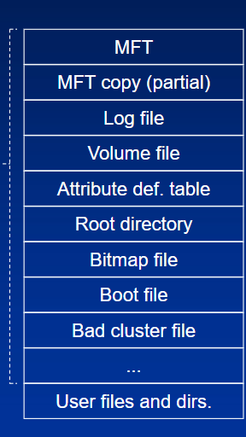
Master File Table
All data stored on a volume is contained in a file
MFT: Heart of NTFS volume structure
Implemented as array of file records
One row for each file on the volume
(including one row for MFT itself)
Metadata files store file system
structure information (hidden files; $MFT; $Volume...)
More than one MFT record for highly fragmented files
Nfi.exe Utility from OEM Support Tools allows to dump
MFT content (see support.microsoft.com/support/ kb/articles/Q253/0/66.asp)

Slide 58
NTFS operation
Mounting a volume
NTFS looks in boot file for physical address of MFT ($MFT)
2nd entry in MFT points to copy of MFT ($MFTMirr)
used to locate metadata files if MFT is corrupted
MFT entry in MFT contains VCN-to-LCN mapping info
NTFS obtains from MFT addresses of metadata files
NTFS opens these files
NTFS performs recovery operations
File system is now ready for user access

Slide 59
NTFS metadata
NTFS writes to log file ($LogFile)
Record all commands that change volume structure
Root directory:
When NTFS tries to open a file, it starts search in the root directory
Once the file is found, NTFS stores the file‘s MFT file reference
Subsequent read/write ops. may access file‘s MFT record directly
Bitmap file ($Bitmap):
stores allocation state volume; each bit represents one cluster
Boot file ($Boot):
Stores bootstrap code
Has to be located at special disk address
Represented as file by NTFS -> file ops. possible (!) (no editing)

Slide 60
NTFS metadata (contd.)
Bad-cluster file ($BadClus)
Records bad spots on the disk
Volume file ($Volume)
Contains: volume name, NTFS version
Bit, which indicates whether volume is corrupted
Attribute Definition Table ($AttrDef)
Defines attribute types supported on the volume
Indicates whether they can be indexed, recovered, etc.

Slide 61
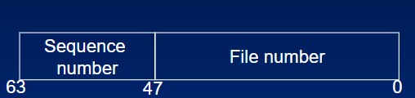
File Records & File Reference Numbers
File on NTFS volume is identified by file reference
File number == index in MFT
Sequence number – used by NTFS for consistency checking; incremented each time a reference is re-used
File Records:
File is collection of attribute/value pairs (one of which is data)
Unnamed data attribute
Other attributes: filename, time stamp, security descriptor,...
Each file attribute is stored as separate stream of bytes within a file

Slide 62
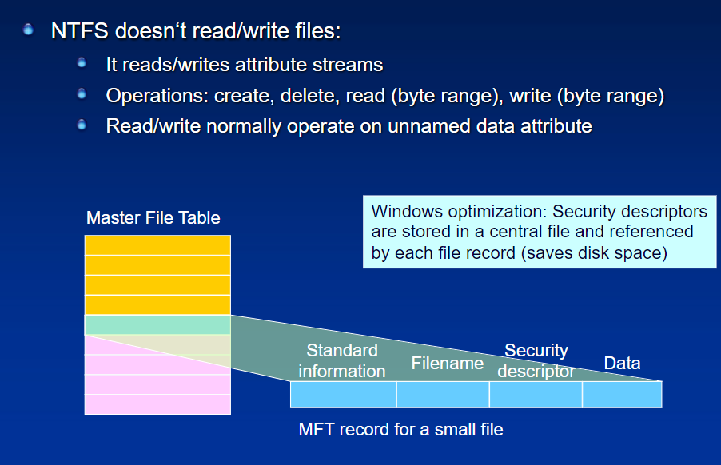
File Records (contd.)

Slide 63
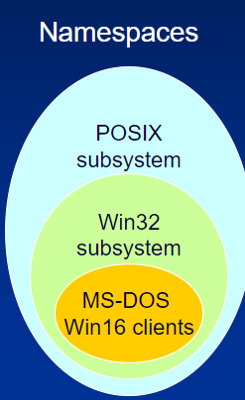
Filenames
POSIX: Win32: MS-DOS: Namespaces
Case-sensitive, trailing periods & spaces
NTFS namespace equiv. to POSIX space
Win32:
Long filenames, unicode names
Multiple dots, embedded spaces, beginning dots
MS-DOS:
8.3 names, case does not matter
NTFS generates MS-DOS names for Win32 files automatically
Fully functional aliases for NTFS names
Stored in same directory as long names; dir /x

Slide 64
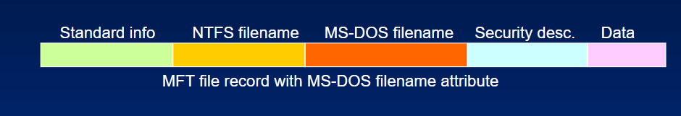
MS-DOS filenames in NTFS
NTFS name and MS-DOS name are stored in same file record and refer to same file
Renaming changes both filenames
Open, read, write, delete work with both names equally
POSIX hardlinks are implemented in similar way
Deleting a file with multiple names only decreases link count
Generation of MS-DOS names:
Remove all illegal chars; remove all but one period; truncate to 6 chars
Append ~1 to name; truncate extension to 3 chars; all uppercase
Increment ~1 if filename duplicates an existing name in directory

Slide 65
Windows - NTFS Extensions
Disk quotas on per-user bases
Security descriptors (ACLs) can be stored once but referenced in multiple files
Native support for properties (OLE), including indexing
Reparse points – implementation of symbolic links
Mount points for arbitrary file system volumes
Support for sparse files
Distributed link tracking (via global object Ids)
Renaming the target file will no longer break links (shortcuts...)
Add disk space to an NTFS volume without reboot
No decompressing when transmitting files over network

Slide 66
File System Driver Architecture
Local File System Drivers (Local FSDs):
Ntfs.sys, Fastfat.sys, Udfs,sys, Cdfs,sys
Responsible for registering with the I/O manager and volume recognition/integrity checks
FSD creates device objects for each mounted file system format
I/O manager makes connection between volume‘s device objects (Created by storage device) and the FSD‘s device object
Local FSDs use cache manager to improve file access performance
Dismount operation permits the system to disconnect FSD from volume object
When media is changed or when application requires raw device access
I/O manager reinitiated volume mount operation on next access to media

Slide 67
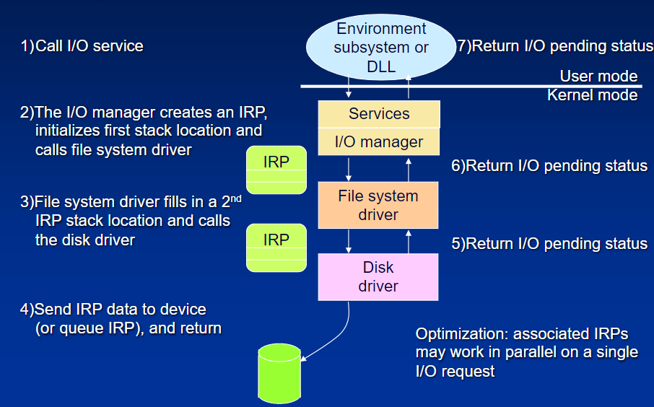
Layered Drivers - I/O System Architecture

Slide 68
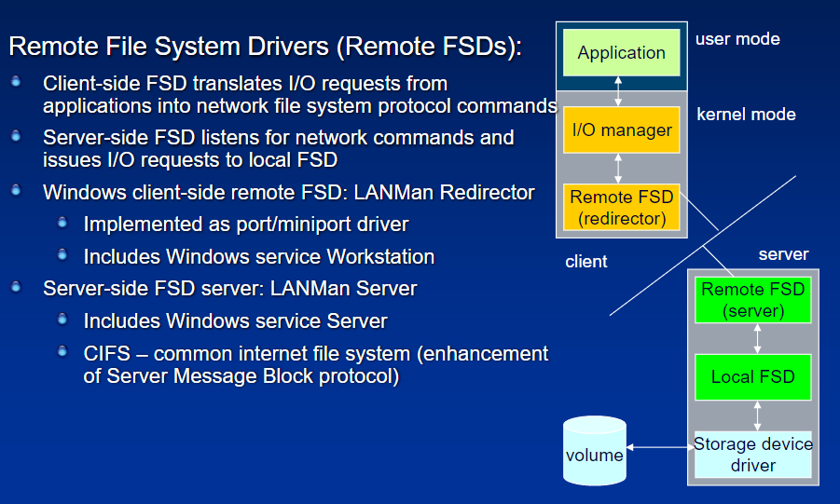
File System Driver Architecture (contd.)

Slide 69
Source Code References
Windows Research Kernel sources do not include NTFS
A raw file system driver is included in \base\ntos\raw
Also see \base\ntos\fstrl (File System Run-Time Library)

